Slide 1

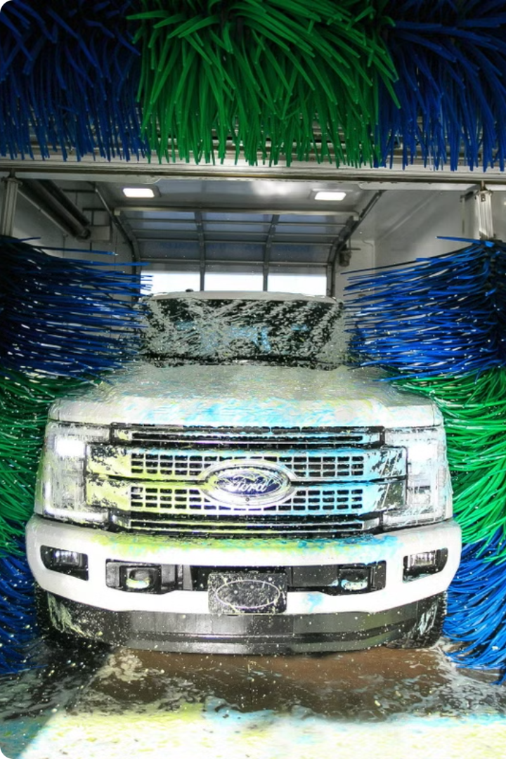


Introduction to Car Washing Management System
The car washing management system is a comprehensive solution for automating and optimizing car wash operations.
by jayanth s

Slide 2
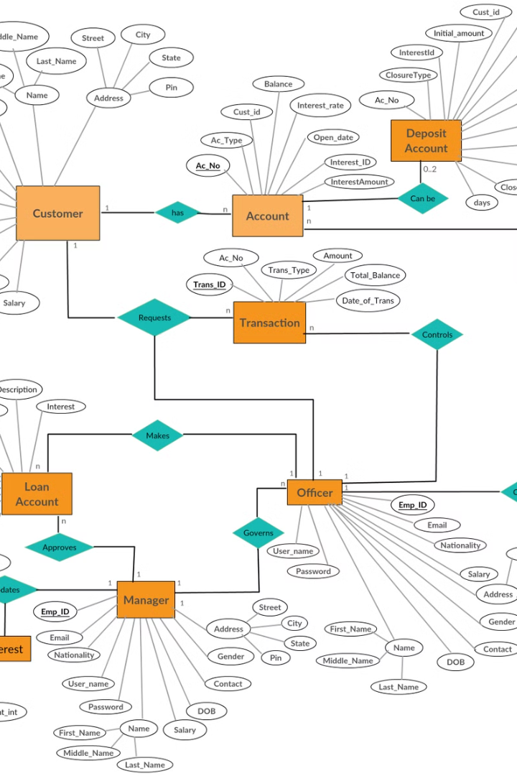
ER Diagram
Entity-Relationship (ER) diagrams depict the structure of a database system, showing the relationships between different entities and data flow.

Slide 3
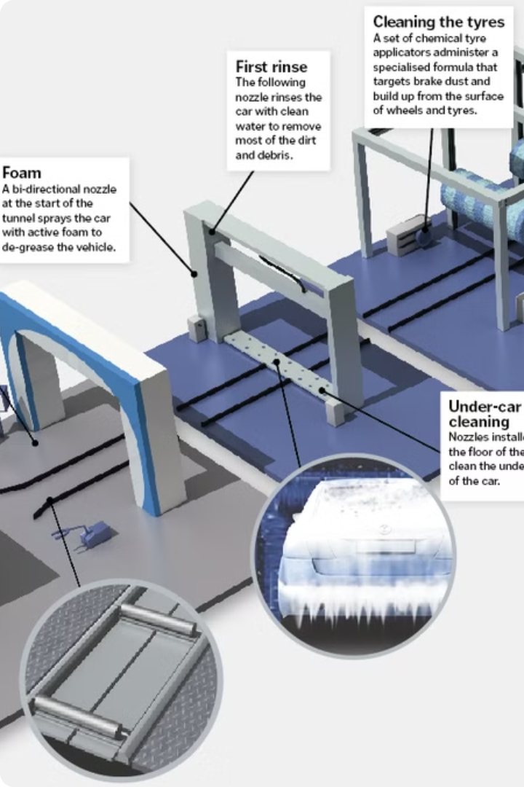
Only Schematic Diagram
A schematic diagram showcases the layout and components of the car washing system, providing an easy-to-understand visual representation.

Slide 4
Methodology
1. Analysis of Current Process
2. Designing Automated Workflow
3. Implementing Monitoring Systems
The methodology involves analyzing the current car washing process, designing an automated workflow, and implementing monitoring systems for efficient operations.

Slide 5
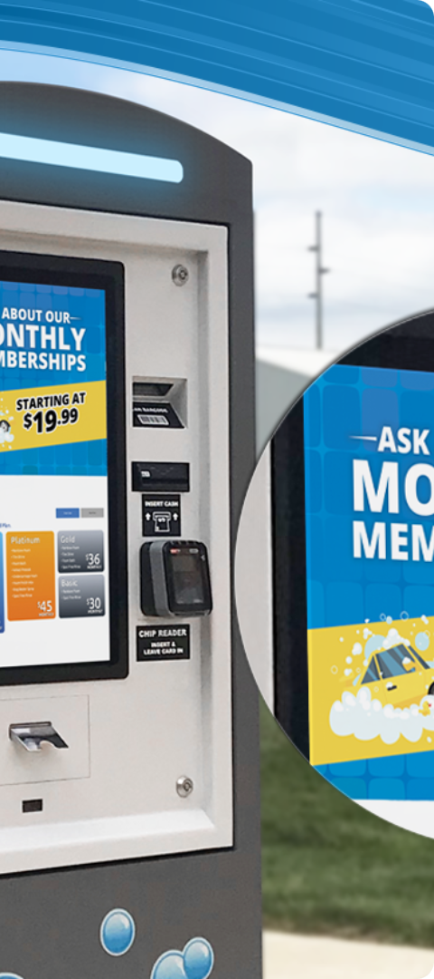
Requirements
1
User-Friendly Interface
2
Integrated Payment Systems
The system should have an intuitive interface for staff to efficiently manage car wash operations.
Integration with various payment options, such as cards and digital wallets, for customer convenience.
3
Data Analytics Capabilities
Ability to generate reports and analyze data for informed decision making and process optimization.

Slide 6

Results
Clean and Gleaming Cars
Automated car wash system ensures spotless and gleaming results, enhancing customer satisfaction.

Slide 7
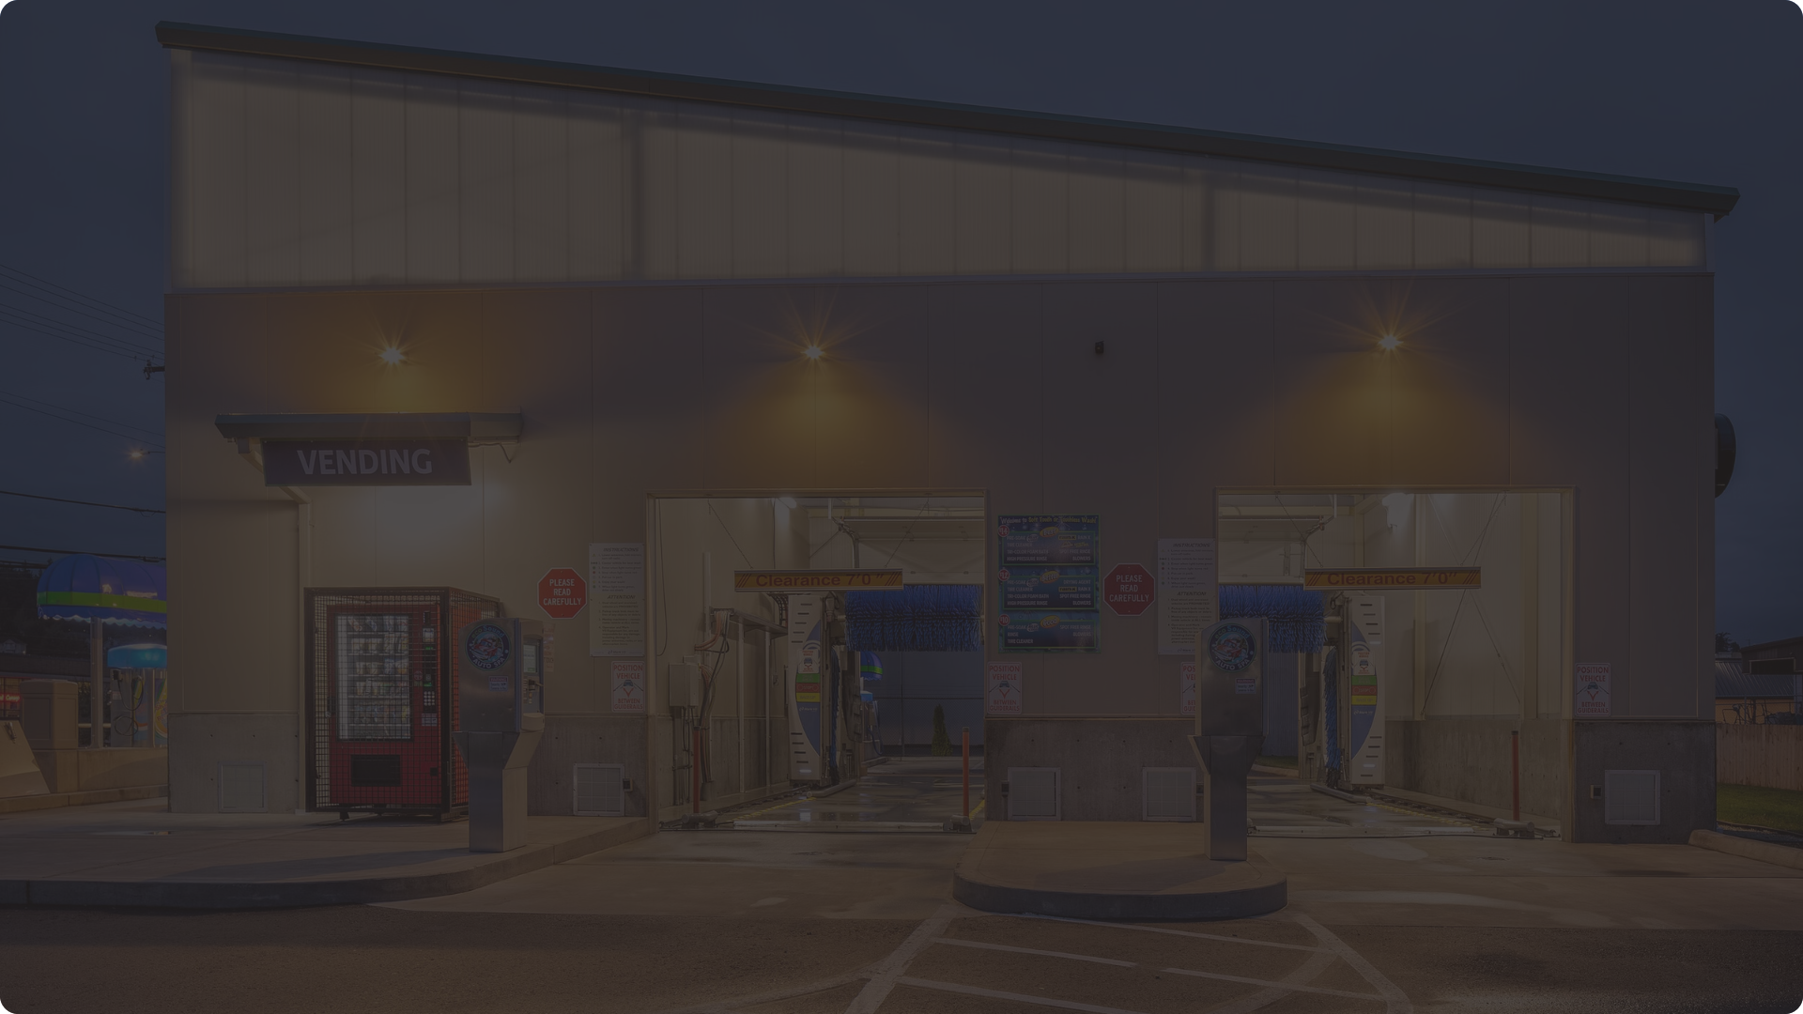
Conclusion
Key Takeaways
Efficiency Boost
Enhanced Customer Experience
Streamlined Operations
Automated operations boost overall efficiency, reducing time and resource consumption.
Streamlined processes lead to optimal resource allocation and cost-effectiveness.
The modern system enhances customer experience with faster service and superior results.

